Slide 1

Break
x Minute Break
See you back in x

Slide 2
Product structure

Slide 3
Product Structure
P2P (LANLink P2P)
H&S (LANLink H&S)
A2A (E PN)
Product
Topology
Coverage
Access Type
Bandwidth
Resilience
Access Technology
Interface
Connectors
Special Features
Proactive Fault Notification
Performance Reporting
Class of Service
Demarcation Device
Metro
National
International
RJ45
SC/PC
LC
Colt Fibre
Leased Line
ULL
EoMSP
EoFibre
Ethernet / NNI
Ethernet
10/100BaseT
1000BaseT
1000BaseSX/LX
2Mb – 600Mb
1Gb
2Gb – 10Gb
Unprotected
Protected
Gold/Platinum
Notes:
This shows the overall structure and attributes of our Ethernet products.
A key one is topology, which defines the key service lines in the product – P2P, H&S, and Ethernet Private Network.
We will consider all of these as we go through the services and underlying technologies
Example service strings:
LANLink P2P Metro , 100Mbps, Protected, A:End Colt Fibre, EoMSP, B:End Colt Fibre, EoMSP, RJ45
LANLink P2P National , 10Mbps, Protected, A:End Colt Fibre, EoMSP, B:End 3rd-Party Leased Line, Ethernet NNI, RJ45

Slide 4



Annex – Product Lines

Slide 5






High bandwidth portfolio …
Optical
Ethernet
IP
Voice
Wave
Ethernet Line
IP Access
SIP Trunking/ ISDN
Private Wave
Private Ethernet
SD WAN
Cloud UC
Spectrum
Ethernet Hub&spoke
IP VPN
IN Services
Dark Fibre
Ethernet VPN
DDOS Mitigation
Service Provider Solutions
Based on new optical platform
Based on new integrated packet network

Slide 6








Colt Optical Services Portfolio
A comprehensive & scalable portfolio for all high bandwidth requirements
Wave
Private
Wave
Spectrum Services
Dark
Fibre
Wavelength services from 10Gbps to 100Gbps
Colt Fibre end-to-end
Resilient infrastructure & diversity options
Over 100 optical PoPs in 18 countries
Private optical solutions
Customer-dedicated equipment & fibre
Wide protocol & topology support
Highly secure
Alien Wave transport over diverse, high availability optical backbone
Very high bandwidths – Terabit-scale networks
Unlimited scalability
Readily available in 42 metro networks in Europe
Long-haul dark fibre with co-location
Direct connection to over 600 key data centres
Key Propositions
Optical DC Net
Over 600 Colt fibre connected DCs in Europe and Asia
Ultra Low Latency
Special low-latency route options for financial traders
Smart City / Mobile Backhaul
Cell site connectivity for enabling wireless services

Slide 7








Colt Ethernet Services Portfolio
High-quality, cost efficient Ethernet connectivity, point to point and multi-site
Ethernet
Line
Ethernet
H&S
Ethernet
VPN
Private
Ethernet
Point-to-point Ethernet service delivered on packet infrastructure
Simple cost effective layer 2 connectivity between two sites
Point to Multi-point Ethernet service delivered on packet infrastructure
Connecting multiple locations to a single location with aggregated hand-off
Multi-site Ethernet connectivity delivered on switched packet infrastructure
Interconnecting customer HQ & branches with a provider managed WAN
Point to Point Ethernet Service delivered on customer dedicated infrastructure (fibre+CPE)
Lowest latency Ethernet product
Key Propositions
DCNet
Over 700 Colt fibre connected DCs in Europe and Asia
Dedicated Cloud Access
Ethernet secure & reliable connectivity to the main Cloud Service Providers
On Demand Services
Real time self-serve connectivity solutions between all customer sites

Slide 8




Colt IP Services Portfolio
A premium set of IP services to securely access to all customer sites, Internet, Cloud Service Providers...
DDoS
SD WAN
Internet
Access
DDOS
Mitigation
IP VPN
Always on, no service activation (monitor around the clock)
Active protection as part of the provider backbone
Security incident experts
Hybrid MPLS/Internet WAN networking with virtualised application delivery
Multiple connection type support
Dynamic path selection
Dedicated permanent access to the public Internet: guaranteed & uncontended
Quality Internet Transit services for Carriers
Security and high availability options
IP based virtual private network
Interconnecting customer HQ & branches with managed IP VPN
Any-to-any site connectivity, regardless of sizes
Key Propositions
Dedicated Cloud Access
Secure & reliable access to the main Cloud Service Providers through IP VPN
PrizmNet
Private global Extranet dedicated to Capital Markets to get access to a wide range of content providers

Slide 9





Colt Voice Services Portfolio
A comprehensive IP-based voice portfolio meeting high bandwidth demands in data-intensive markets.
SIP Trunking
ISDN
Cloud UC
IN Services
Service Provider Solutions
VOIP connection which consolidates voice Pan-European to resilient DCs -Enable centralised IP PBX & UC deployments
Traditional ISDN interfaces to TDM PBXs - Site by site architecture for voice calling to PSTN
Flexible & scalable fully managed end to end cloud-based UC solution
It includes: IP Telephony, Voice minutes (SIP Trunking), and Unified Communications and Collaboration (UC&C)
Inbound calls and non-geographic routing to anywhere in the world - Accessibility to markets, manage dispersed assets
Advanced call routing features and cloud based contact center solution - Customer satisfaction, reduced waiting times, disaster recovery, cost per use model
Unique combination of technical, process and regulatory expertise
API with near real-time number reservation and activation (< 2hrs)
White Label services incl. end-customer invoicing
Unrated CDRs delivered twice daily
Key Propositions
Contact Centres
White Label
Billing and reporting
End-customer invoicing
White Label End-customer invoicing
White Label Helpdesk

Slide 10
Colt products transition

Slide 11
Original Portfolio
New Network Services Portfolio
Ethernet
Optical
Wavelength
Optical 2.5G & 10G SDH
Wave
LANLink P2P
DWDM (10 – 100Gbps)
LANLink P2P
Dedicated Fibre Metro
Private Ethernet
(1-10Gbps)
LANLink P2P
(Ethernet over MSP)
Ethernet Line
(≤10Gbps)
LANLink Hub & Spoke
(Ethernet over MSP)
Ethernet
Hub & Spoke
Ethernet Private Network
(Ethernet over MSP)
Ethernet VPN
High Speed Service
Private Wave
Dark Fibre
Dark Fibre
Spectrum

Slide 12
Product topologies

Slide 13





Colt offers the full range of MEF defined services
Product | Colt Ethernet Line (Point-to-Point) | Private Ethernet | Colt Ethernet Hub and Spoke | Colt Ethernet VPN (E-VPN)
Topology | Point-to-Point | Point-to-Point | Hub and Spoke | Any-to-Any
Bandwidth | 2Mbps – 40Gbps | 1Gbps -100Gbps (Dedicated Fibre, Metro only) | 1Gbps, 10Gbps, 100Gbps NNI (Hub) Spokes ≤ 10Gbps | 2Mbps – 40Gbps
 | Ethernet Private Line (EPL &EVPL) | Ethernet Private Line (EPL) | Access Service with E-NNI handoff | Transparent LAN Service
 | E-Line (EPL / EVPL) | E-Line (EPL) | E-Access | E-LAN (EPLAN / EVPLAN)
E-Line, E-Access and E-LAN CE2.0 certified on M-MSP platform (will need re-certifying on IQNet!)
Notes:
You may have heard of an organisation called the MEF, the Metro Ethernet Forum, which exists to promote Ethernet technology and services.
We provide the full range of Ethernet service types as defined by the MEF, P2P, H&S and Any to Any, all of which are available on a port or virtualised ‘VLAN’ handoff.
Metro, National, International services can be provided in combination and seamlessly integrated in mult-site solutions.
So, Colt offers the full range of MEF-defined topologies, including E-Line, “P2P” services up to 100Gbit/s, E-Access services including 10Gbps E-NNIs, as well as E-LAN and E-Tree any-to-any services up to 10Gbps
Colt are already MEF Carrier Ethernet 2.0 compliant, and we are just completing the CE 2.0 certification, upon which Colt will be the only service provider in Europe to have certified ALL the MEF service types - E-Line, E-Access, E-LAN and E-Tree.
Why does it matter? Because this is your assurance that the products will ‘do what it says on the tin’, so to speak, perform as expected and can be relied upon to integrate with your solutions and meet the needs of the most demanding business applications.
(Carrier Ethernet 2.0 (CE 2.0) is the next generation Ethernet Service Specification from the Metro Ethernet Forum (MEF)

Slide 14
Colt Access Technologies

Slide 15










Overview of all access technologies
Colt Fiber
Ethernet MSP fibre rings
Off-Net - Ethernet (or SDH) leased lines
Colt ULL SDSL,EFM (copper)
Colt network
Partner networks
(Colt Fibre ULL)
Wholesale DSL (wDSL)
Public Internet
Fixed and wireless remote users
3G PDA connected to the public Internet
(only as part of Colt IPVPN)
Notes:
Colt already have multiple options for connecting customers to the Colt products and services
On-Net via Colt Fibre: Colts traditional On-Net fibre ring based service using either SDH or Ethernet over MSP technology.
On-Net Unbundled Local Loop offerings: traditionally unbundled copper infrastructure but now unbundled Fibre too!
Off-Net OLO tails – SDh or Ethernet either point to point or via NNIs
Off-Net wDSL – third party DSL or FTTx options
Internet based access – traditionally used for IP VPN or IP access as low cost or backup services

Slide 16










Access technologies
Ethernet over Fibre
Multi Service Platform
Off Net (Ethernet or Leased Lines)
COLT Network
Other
Operator
Off Net Ethernet (wDSL)
Ethernet over COLT SDSL & Ethernet in the First Mile (EFM)
Ethernet over SDH
Notes:
Direct Connection:
COLT’s pan-European network connects 32 major cities
for those located further from our network, we can deliver access in 3 ways:
Other Licence Operators (OLOs):
where one or more of your sites is located too far away from the COLT network for direct connection we can still deliver a complete solution by working with an other licensed operator
COLT has agreements with 50 carefully chosen partners to ensure broad reach beyond our own network
these partners are carefully selected specifically for providing Ethernet services which support COLTs service requirements
we will order a circuit or circuits from the OLO on your behalf, and you will still be dealing directly with COLT at all times
we also take responsibility for testing the interface between our network and the OLO’s circuit to ensure that your service is seamless
DSL:
we can also connect your sites using our DSL service, COLT has unbundled local loop in 11 countries within Europe, with a total of 550 central offices (with plans to increae this to 600 by end of 2007)
typically speeds of up to 4Mbps are available across Europe – with EFM (Ethernet in the first mile), this is available now to 8Mbps and will increase to up to 20Mbps
we can also use the DSL of OLOs – this is referred to as wholesale DSL or wDSL and extends COLTs DSL coverage to national availability in 12 European countries
whichever way we connect your sites to our Ethernet services, your solution will be created and managed by COLT – under a single end-to-end Service Level Agreement

Slide 17






Access Comparisons (Diagram)
Colt Node
On-Net Fibre
3rd Party Central Office
Fibre ULL
3rd Party Central Office
On-Net EFM (copper ULL)
3rd Party Central Office
Off-Net wDSL
Off-Net Fibre (OLO)
Notes:
All elements in blue are Colt owned and managed.
Infrastructure in green are provided by a third party.
Fibre ULL will be available in 2015 and utilises a single fibre passive connection to the customer from a third party central office in the last mile. Colt will use it’s own MSP infrastructure to supply standard Colt services.

Slide 18
Colt Access technologies
1
Colt Fiber Solution: Next Gen. Network
Colt EFM: Ethernet in the First Mile
SDSL – wholesale DSL
Other Licensed Operator (OLO)
3G (IP products only)
Colt ULL FTTx
2
3
4
5
6

Slide 19
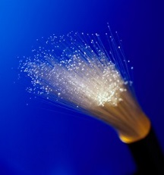
1
Colt Fiber – Next Generation Network
Colt On-net
Ethernet based Next Generation backbone of Colt
Provides access and transport for all Colt products
If site is connected with Colt fiber – max bandwidth: virtual ‘unlimited’
Colt Fiber available in all Colt countries / Colt cities
EU vs Asia
Network expansion programme: further deployment of our fiber backbone
New Colt MAN: 49 MAN -> Connecting new Colt cities (ongoing process)
New buildings: Building Connectivity Process (BCP process)
Use MBL (Master Building List) available via Colt online (Colt Xplore)
PAON - http://intranets/Intranet/BusinessUnits/NetworkServices/OrganisationStructure/SBD/Strategybidandassetmanagement/Pre-ApprovedOn-Net/index.htm
http://intranets/Intranet/BusinessUnits/NetworkServices/OurNetwork/AccessData/index.htm
Notes:
19

Slide 20
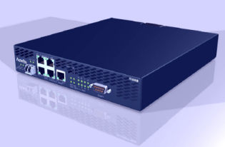



2
Colt EFM (Ethernet First Mile)
Ethernet in the first/last mile based on Copper infrastructure
Copper is an electrical signal – so there is attenuation => Max bandwidth speed up to 40 Mb
Colt EFM bandwidths are guaranteed, symmetrical and uncontended (1:1)
Premium SLA in all Colt countries ! Cfr Product SLA
Only available in cities where Colt fiber is available
Colt Network
PTT
Central Office
PTT Network
Customer
Premise
Colt
Ethernet network
Colt / OLO
Fibre Ring
PTT
copper network
EFM
Colt MSP
Colt
MSP
CPE
Colt
EFM
DSLAM
Colt EFM
CPE
Colt
IP Router
http://intranets/Intranet/BusinessUnits/NetworkServices/OurNetwork/AccessNetworks/index.htm
Notes:
20

Slide 21
3
Wholesale DSL as an access technology
wDSL = Wholesale Digital Subscriber Line is a low cost, low bandwidth Access Product.
Colt Wholesale DSL – general name for all xDSL flavours (non Colt EFM)
wDSL utilises various technologies from the incumbent providers including
Very-high-bit-rate DSL (VDSL)
Asymmetric DSL (ADSL)
Symmetric DSL (SDSL)
As infrastructure is based on copper => bandwidth depends on attenuation / distance
Bandwidth flavours
from symmetrical up to a-symmetrical
from uncontended (1:1) up to contended bandwidth (e.g. 2:1, 4:1, 10:1)
2 Mb (2:1) = guaranteed bandwidth of 1 Mb with ‘bursting’ upto 2 Mb
wDSL Country by Country Product Breakdown :
http://intranets/intranetUCM/groups/intranet/@division/documents/digitalasset/intranet_119586.xls
Also use Colt Xplore – connectivity check
Notes:
21

Slide 22
4
OLO – Other Licensed Operators
No Colt fiber, no Colt EFM, nor wDSL availability => 3rd party OLO tail is the only solution
An OLO tail can be based on 3rd party Fiber, Copper or even wireless connection
OLO options: long lining, MPLS NNI, Ethernet NNI,….
OLO tails are also known at colt as leased lines offered by 3rd party operator
Colt always have a back to back SLA with 3rd party provider
Colt used only certified OLO providers
OLO tail information via the Colt Xplore tool
If you would like to have more information (background) about OLO tail:s
http://intranets/Intranet/BusinessUnits/NetworkServices/OurNetwork/AccessNetworks/PartnerAccess/index.htm
http://ciw/sites/ccs/strategy/BI/matrix/Shared%20Documents/Forms/AllItems.aspx
http://conlintrap.eu.colt/intranetUCM/idcplg?IdcService=GET_FILE&dDocName=INTRANET_115357&RevisionSelectionMethod=Latest
Notes:
22

Slide 23
5
3G/4G as primary access
This is an access technology for IP products only (Colt IPVPN no Colt IP Access nor IP Access office)
3G/4G can be used as prime access as well as backup access
Can be offered as a partially (hardware only) or fully inclusive (hardware and subscription)
Remark: 4G is already available for partially inclusive but not yet available on fully inclusive (using Vodafone

Slide 24
6
Colt Fiber ULL Access Network
Colt Network
PTT
Central Office
EFM
PTT Network
Customer
Premise
Colt
Ethernet network
Colt / OLO
Fibre Ring
PTT
copper network
Colt MSP
Colt
MSP
CPE
Colt
EFM
DSLAM
Colt EFM
CPE
Colt
IP Router
Fibre ULL
Colt
Ethernet network
Colt / OLO
Fibre Ring
OLO fibre network
Colt MSP
Core device
M-MSP
(Accedian LT-S)
1G
M-MSP CPE
(Accedian GT)
Unmanaged (passive) dark fibre between CO and Customer Building
Third party fibre based on FTTH deployments
Initial launch in France and Switzerland (not yet in BeNeLux)
Supports 2Mbps – 1Gbps services

Slide 25




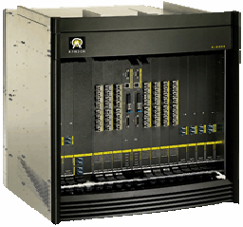

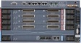
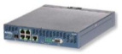
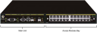

Unbundled Local Loop (ULL) – Colt DSL
OLO Central Office
DSLAM
COLT Nodes
Customer site
Distribution Frame (DF):
The OLO connects the customer’s copper pairs from their equipment and patches them onto COLT’s demarcation
CPE
Copper Pairs
DSL Modem

Slide 26
Summary - what access technology to use
If Colt fiber is possible, max bandwidth is unlimited and support of all products
MOAW program: Make Our Assets Work
If not then use…
Colt EFM is possible, speed from 2 Mb to 40 Mb
EFM is copper so depends on distance cu pair
If not then use…
Colt Wholesale DSL (symmetrical) is possible, speed from 2 Mb to 10 Mb
EFM is copper so depends on distance Cu pair
If not then use…
OLO tail (symmetrical) is possible, speeds from 2 Mb up to ….

Slide 27
OSI Model
International Organization for Standardization (ISO) began to develop its OSI framework architecture
Characterizing and standardizing the functions of a communications system in terms of abstraction layers
Similar communication functions are grouped into logical layers
An instance of a layer provides services to its upper layer instances while receiving services from the layer below
The concept of a seven-layer model was evolved from experiences with the ARPANET

Slide 28
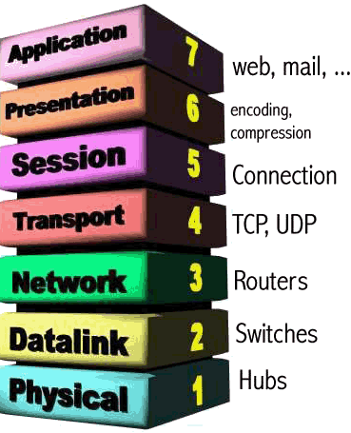
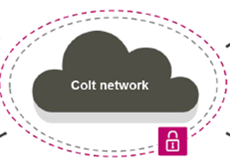
OSI Stack
Layer-3 (IP)
Layer-2 (Ethernet)
Interfaces, Connector, Access layer

Slide 29
OSI Model (cont.)
OSI Model
 | Data unit | Layer | Function
Host layers | Data | 7. Application | Network process to application
 |  | 6. Presentation | Data representation, encryption and decryption, convert machine dependent data to machine independent data
 |  | 5. Session | Interhost communication, managing sessions between applications
 | Segments | 4. Transport | End-to-end connections, reliability and flow control
Media layers | Packet/Datagram | 3. Network | Path determination and logical addressing
 | Frame | 2. Data link | Physical addressing
 | Bit | 1. Physical | Media, signal and binary transmission
interaction with user and interaction with applications on other computers.
converting data to a standard correct format, so that the receiving layer can understand it.
establishing, maintaining, and terminating the communications between the two devices.
segmentation of data.
data delivery across internetwork and path determination.
adapting data to whatever physical layer technology that will be used.
moving the data on and off the network medium, e.g. pin-outs, electrical voltages, cabling standards, etc.

Slide 30
OSI/ISO vs. TCP/IP
Application
Application
Presentation
Session
Transmission
Transport
Network
Internet
Data Link
Network
Access (*)
Physical
OSI Model
TCP/IP Model

Slide 31



What is IP?
1
© 2010 Colt Telecom Group Limited. All rights reserved.

Slide 32
The Internet Protocol
Introduced as Internet Protocol Suite in 1974, IP was the connectionless datagram service in the original Transmission Control Program
Is the primary protocol that establishes the Internet
Is responsible for addressing hosts and routing datagrams (packets) from a source host to the destination host across one or more IP networks
Addressing refers to how end hosts get IP addresses assigned and how sub networks of IP host addresses are divided and grouped together
A header is tagged to each packet → called encapsulation
Notes:
the other being the connection-oriented Transmission Control Protocol (TCP)
The Internet Protocol Suite is therefore often referred to as TCP/IP
http://tools.ietf.org/html/rfc675

Slide 33
An IP Address
Used to uniquely address each device on a TCP/IP network.
Is a 32 bit number divided into network and host parts.
e.g. 20.36.5.8
8 bits
8 bits
8 bits
8 bits
20
36
5
8
Network part
Host Part

Slide 34
A Network Mask
Is used by computers to work out the boundary of network/host parts of an IP address.
Is a 32 bit number divided into network and host parts.
e.g. 255.0.0.0
8 bits
8 bits
8 bits
8 bits
255
0
0
0
Network part
Host Part

Slide 35
Address Classes
Network Part
Host Part
Class A
10
0
0
0
Network Part
Host Part
Class B
173
46
0
0
Network Part
Host Part
Class C
200
10
98
0
Class D
Multicasts
Class E
Experimental

Slide 36
IP Classes A,B and C
Byte
1.
2.
3.
4.
Class A
network
Class B
network
network
Class C
network
network
network
Class
1st Byte
Network/ Byte
Hosts/ Byte
Netmask
# of Hosts
A
0 - 127
1
3
/ 8
> 16 Mio
B
128 - 191
2
2
/ 16
> 65.000
C
192 - 223
3
1
/ 24
= 254

Slide 37
IPv4
The first major version of IP is known as Internet Protocol Version 4 (IPv4 → 32 Bit Addresses)
Used to uniquely address each device on a TCP/IP network (no duplicates)
4 Bytes (Octets) of 8 Bit each, which limits the address space to 4294967296 (2³²) addresses
Some address blocks are reserved for special purposes such as private networks, localhosts and multicast addresses
Notes:
private networks (~18 million addresses) and multicast addresses (~270 million addresses)

Slide 38
IPv6
Developed to deal with this long-anticipated IPv4 address exhaustion
Uses 128-bit addresses, for an address space of 2¹²⁸ (approximately 340 undecillion or 3.4×10³⁸) addresses
Implements additional features like stateless address autoconfiguration (SLAAC) or simplification of router announcements when changing Internet connectivity providers
Does not implement interoperability features with IPv4 → special translator gateways required
No DHCP needed anymore for most of the applications
Notes:
2¹²⁸(≈ 340 Sextillionen = 3,4·10³⁸)

Slide 39
What is IP Routing?
IP routing is communication between different IP networks
A router is a device that forwards data packets between computer networks and considered to be a Layer3 device
A router is connected to two or more data lines from different networks
If a data packet comes in on one of the interfaces, the router will perform a check of its routing table to find the best way to the destination
CPE
SAR
20.20.20.0/24
40.40.40.0/30

Slide 40
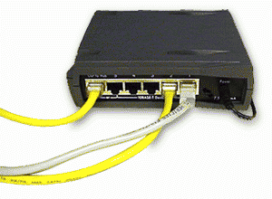
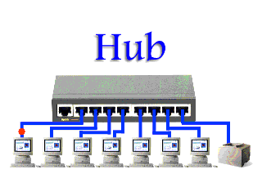
Networking Devices
Hub
Multi-port repeater. Simply passes on (repeats) all the information it receives, so that all devices connected to its ports receive that information.
a lot of unnecessary traffic sent to all devices on the network

Slide 41
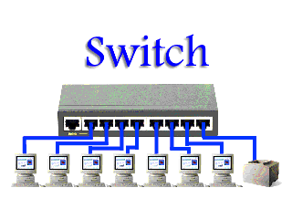
Networking Devices (2)
Switch
Controls the flow of network traffic based on the MAC address information in each packet. A switch learns which devices are connected to its ports (by monitoring the packets it receives), and then forwards on packets to the appropriate port only.
allows simultaneous communication across the switch, improving bandwidth.

Slide 42
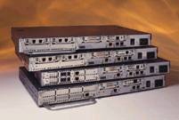
Networking Devices (3)
Router
forwards data according to Layer 3
information (network addresses)
Each interface is in separate network
usually has interfaces for WAN Access
makes routing decisions based on information on routing table
routing table generated by routing protocols or configured by administrator
can have more that one route to the same destination
select which is the best route to destination
if destination is not known, the packet is dropped

Slide 43
Routing and the OSI Model

Slide 44


Routing - Pure packet switching
IP
R1
1.1.1.1
R8
R2
R7
R6
R3
Possible Path
R4
R5
2.2.2.2

Slide 45
Network Technologies

Slide 46
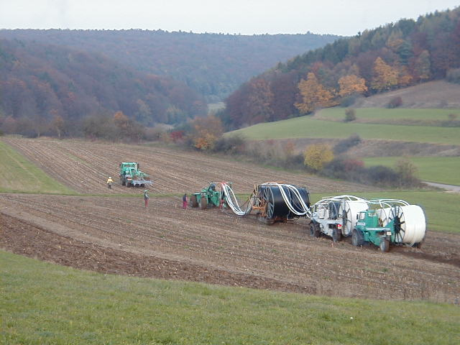
Long Distance Network

Slide 47
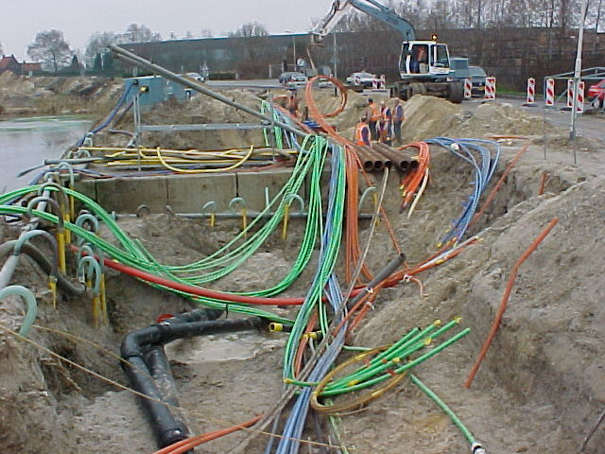
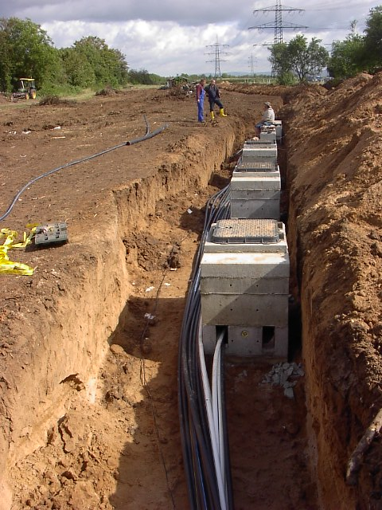
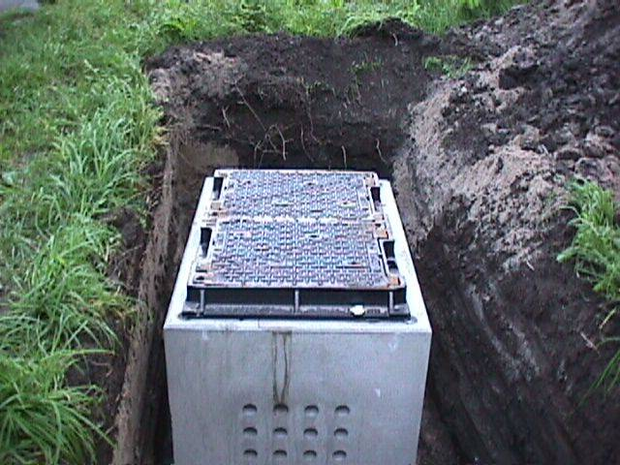
LDN

Slide 48
SDH Network - Logical Network Topology
‘Headend’ or Node mux
The COLT SDH network, generally utilised for Colt Link type services, is based on a number of resilient optical Fibre rings
Traffic Flow
West
East
The node ‘mux’ sits at the logical centre of the SDH network with multiple diverse paths emanating from it to provide services to COLT’s customers.
East
West
West
East
East
West
Customer Muxes
Notes:
The SDH rings which provide customers with direct access into the COLT network begin and end at the Node. There are around 10 nodes in London alone covering areas ranging from Docklands to Heathrow. Each ring is developed to provide resilient services from each customer site. The node not only completes each ring, but also acts as a point of interconnection to the PSTN, to other SDH rings, to carriers, and to the COLT IP network and beyond.
The individual customer rings are connected into head end, or node muxes called Homing Nodes. COLT have utilised 3 equipment vendors for our SDH network, Nortel, Marconi and Lucent, and we tend to keep each ring dedicated to a particular vendor, i.e. all Nortel or all Lucent. Nowadays Lucent is the preferred vendor.
The customer rings are typically STM-1 or STM-4, although we have also provided STM-16 rings. Each ring contains between 2 and 8 elements.
The homing nodes we currently use are STM-64 and have the ability to terminate both STM-1 and STM-4 Customer rings.

Slide 49





COLT Multi Service Platform
Architecture
Customer Sites
COLT Nodes
MSP Core
NNIs
Core element
Access element
IP NNI
EoS NNI
DCN NNI
Notes:
MSP provides a single Ethernet access solution.
Multiple services can be provided from one MSP CPE.
There are 16 physical ports. Many more dedicated services can be provided differentiated by VLAN etc.
Additional equipment may be required at customer site for advanced features on L3 services.

Slide 50
Modular MSP?
NSN
HN
NSN
PE
vendor
Y
vendor
Z
NSN CPE
MSP
NSN
vendor X
NSN CPE
NSN CPE
NSN
HN
NSN
PE
vendor X
vendor X
vendor
Y
vendor
Z
MSP in Colt today
Modular MSP
ALu HN
ALu PE
basic idea behind Modular MSP is to componentise the network into exchangeable modules which are interconnected based on fully standard protocols
ALu CPE
MSP
ALu
ALu CPE
ALu CPE
ALu
HN
ALu
PE

Slide 51
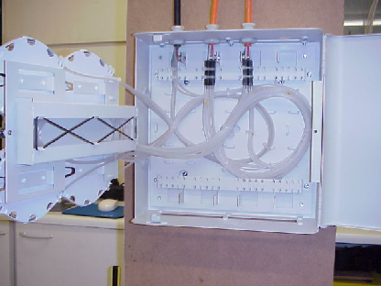
Connecting a building On Net
Interface
cables
Building Flexibility Point
(BFP)
Internal Cable
12/24 fibers
1-12 ducts
some for
future use
Customer Cabinet
Opt Fibre Cable
12-48 fibers
(4 in use)
Opt Fibre Cable
48/96/144 fibers
Flexibility Point
(Footway or carriageway
box)
Notes:
Connecting a building on net - The ducts can accommodate 4 fibre cables (each containing 144 fibres) and terminate in a footway box directly outside the customer’s building. Within the footway box we splice four fibres (representing east and west of the ring) to a separate cable which we run directly into the building through the designated entry point.
Once in the building this cable terminates onto a Building Flexibility Point or BFP. This is a wall-mounted fibre splicing box and is the point whereby the external network cable is spliced onto the internal fibre cable. It is called a flexibility point as a number of different customers can be fed from the same external cable.
On leaving the BFP the fibre is run up the building until it reaches the Customer Termination Point or CTP which is located in the COLT cabinet. This is the point where the COLT installation technicians connect the SDH equipment (or other) on site to the live network.

Slide 52
Dual Entry Building
SDH mux
Presentation Panel
SDH mux
CTP
BFP
24 F
BFP
Flexibility Point
(handhole with
joint = doplas)
Flexibility Point
(handhole with
“fiber splice”)
Notes:
Some customers request extra resiliency for the fibre network entering their building and in such cases we can provide ‘dual entry’. This is where we access the building through two separate entry points, connecting to two separate BFP’s and two separate internal fibre cables. This protects against loss of service due to a fibre cable failure before true resiliency starts from the footway box outside.
This does not protect against equipment failure.

Slide 53

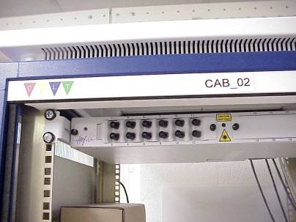
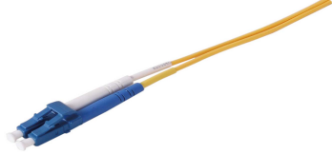
BFP and CTP
External fibre from street is terminated onto an internal cable within the BFP
The internal fibre is terminated on the Colt CTP. From here connections can be made to the CPE, or to an optical patch panel for further connectivity within the comms room

Slide 54
Multi Tennant Building
=< one STM-1
Central Room
Customer Rooms
SDH mux
SDH mux
Presentation Panel
CP-DDF
Presentation
Panel
SDH mux
SDH mux
CTP
CTP
24 F
BFP
24 F
Flexibility Point
(handhole with
joint = doplas)
Notes:
This shows how we can feed several customers from a single building entry point. Additionally in some instances it is more cost effective to connect several customers in the same building to a single SDH mux, this is known as a Common Equipment Area (CEA). In this case we simply connect the ports of the SDH shelf to a long line cable and terminate the other end on a presentation panel within the ordering customers floor.

Slide 55
Connecting a building On Net
2nd Customer Room (different floor for example)
CTP
CPE
Presentation
Common Equipment Area
Customer Room
CTP
CPE
BFP
Long Line
Presentation
Patch Panel
Flexibility Point
(Footway or carriageway
box)
Notes:
Connecting a building on net - The ducts can accommodate 4 fibre cables (each containing 144 fibres) and terminate in a footway box directly outside the customer’s building. Within the footway box we splice four fibres (representing east and west of the ring) to a separate cable which we run directly into the building through the designated entry point.
Once in the building this cable terminates onto a Building Flexibility Point or BFP. This is a wall-mounted fibre splicing box and is the point whereby the external network cable is spliced onto the internal fibre cable. It is called a flexibility point as a number of different customers can be fed from the same external cable.
On leaving the BFP the fibre is run up the building until it reaches the Customer Termination Point or CTP which is located in the COLT cabinet. This is the point where the COLT installation technicians connect the SDH equipment (or other) on site to the live network.

Slide 56
What is in a Customer Cabinet?
CTP
COLT Termination
Panel
Presentation Panel
(also known as customer DDF, can be located at
Base of COLT cabinet – country specific)
single door with door-switch monitored through
SDH-management
Optional : NOKIA
Primary Multiplexer
or Managed Router
????
SDH-mux
almost always other equipment is
also present, such as PDH-mux, router
optional
Batteries
supplies 4 hours of power backup
Power Supply Unit
(220VAC-> 48VDC PSU)
Always one extra rectifier
Notes:
A typical COLT cabinet consists of a Power supply Unit, which converts 240VAC to 48VDC to feed all the equipment housed within the rack . In case of a Power fail the cabinet is also supplied with a set of four batteries, these provide around 4-6 hours of power should a power failure occur.
There is almost always a form of SDH equipment within the cabinet which is connected into the CTP.
On occasions an extra box may also be fitted within the same rack to provide a service type, for example a router for Internet access, or a switch as part of a managed network solution.
The presentation panel is also known as the COLT demarcation point, its where our circuit is presented to the customer for connection and where our service effectively terminates in the building.

Slide 57
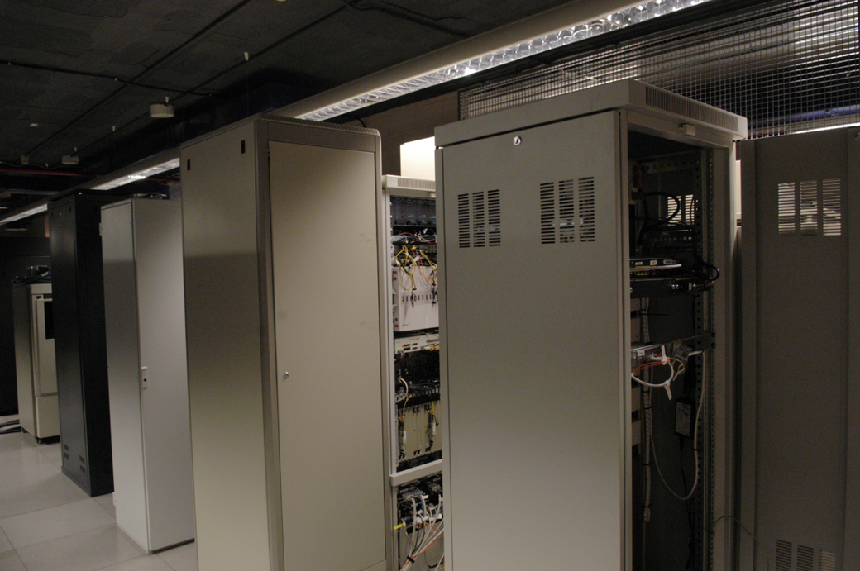
Comms Room at Customer Site
Colt CPE - Overture Demarcation Device

Slide 58
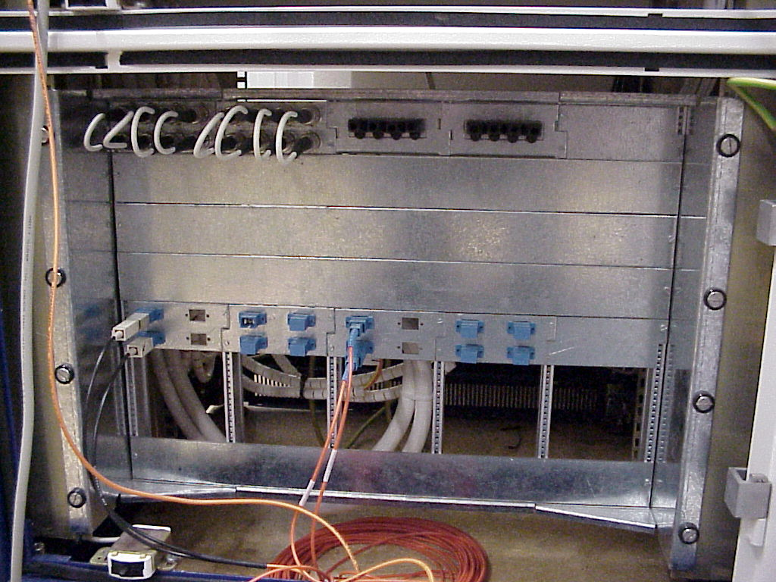
Presentation Panel

Slide 59
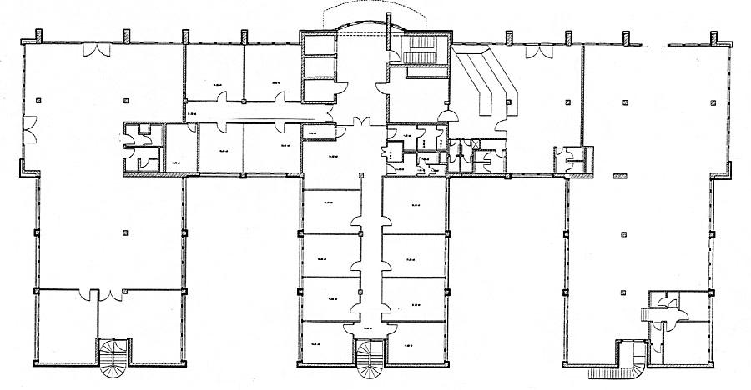

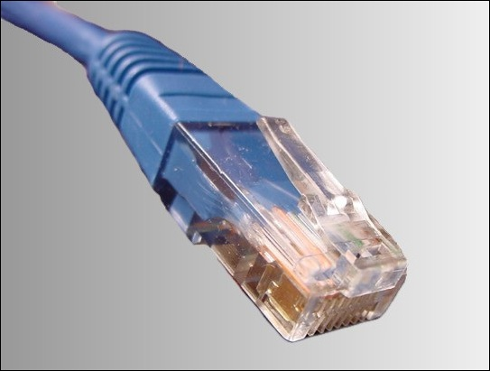
RJ45
RJ45 (Registered Jack nr. 45)
Cat 5 UTP (Unshielded Twisted Pair)
Customer Offices

Slide 60
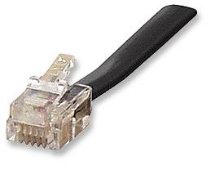
RJ11
RJ11 (Registerd Jack nr. 11)
Let’s look more closely now
Customer Offices

Slide 61
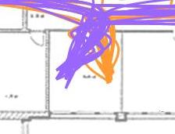
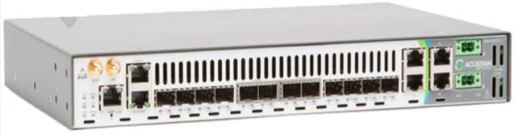
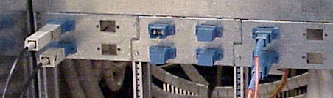
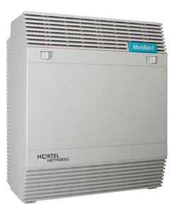
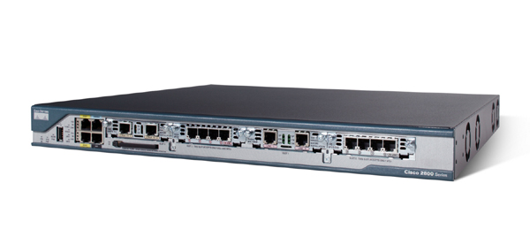
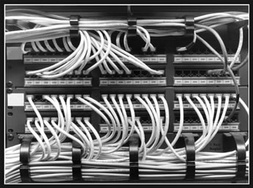
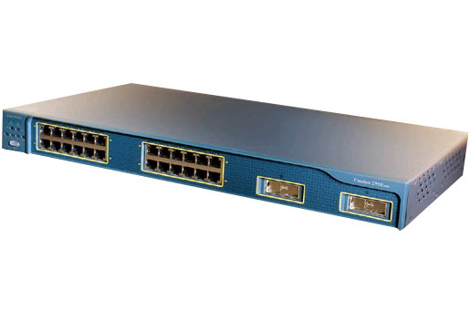
A possible scenario
Let’s look more closely now
> To the Network!
presentation panel (On-Net)
> To the CPE/Mux
Router
PABX
Customer Offices
Switch
patch panel

Slide 62
Resilience

Slide 63
Definitions
Diversity | The extent to which a service is provisioned over discrete and geographically separate elements from another service
Redundant | An infrastructure, service or network element that is duplicated such that a critical failure will not cause a serious and prolonged loss of service in customer services running on that infrastructure or network component
Resilience | Ability to provide and maintain an acceptable level of service in the face of faults and challenges to normal operation.
A given level of resilience is the outcome of the levels of redundancy and diversity embedded in the infrastructure that supports a service or solution, setting aside other environmental and operational factors

Slide 64
Enhanced availability – a matter of options
Dual entry
Dual fibre entry into buildings with self healing rings
ISDN backup
Fully inclusive or partially inclusive ISDN Backup Service with automatic failover
DSL backup
Additional Colt managed CPE router with automatic failover to DSL backup service
Dual access
Two Colt managed CPEs on two access circuits running a Virtual Router Redundancy Protocol (VRRP) with automatic failover
Internet backup
Additional Colt managed CPE router with automatic failover to Internet backup service
Wireless backup
3G wireless backup access to the IP VPN when the primary Colt IP VPN access circuit is disrupted
Notes:
Dual Entry
Colt can provide dual diverse entries into a customer's building. This is a more resilient configuration than single entry, and the additional costs of providing dual entry will be charged to the customer.
ISDN Backup
There are now a number of Integrated Services Digital Network (ISDN) backup options available. Each option allows the customer to decide how the backup option will operate and who provisioned the ISDN line. These options range from the customer provisioning their own ISDN line (partially inclusive) through to a fully inclusive managed ISDN backup service from Colt (click > to see diagram).
DSL Backup
DSL Backup enables Colt to provide DSL access as a backup method to primary access options such as fibre, leased line and DSL (click on > to see diagram).
Dual Access
Two access circuits connect to two Colt managed CPEs running Virtual Router Redundancy Protocol (VRRP), providing automated failover from primary to secondary circuits (click on > to see diagram).
Internet backup
Outside of Colt countries, ISDN Backup, DSL Backup and Dual Access are not always feasible or available. Within Colt countries, ISDN is limited in bandwidth, DSL not always available and OLO tails costly. To assure the best resiliency a third party (Expereo) will deliver the 3rd party Internet connectivity
Wireless backup
Provides 3G wireless backup access to the IP VPN when the primary Colt IP VPN access circuit is disrupted. Colt will install CPE routing equipment (one box solution) that will handle the wireless backup, using GPRS, EDGE, HSDPA or UMTS wireless interface. The service is based on 3G wireless Internet (not a 3G wireless private service)

Slide 65

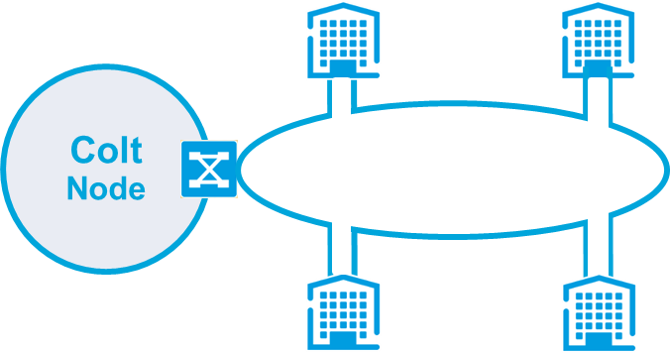
Dual Entry vs Single Entry
Single Entry
Fibre enters and exits building through same duct
Dual Entry
Fibre enters building through duct ‘A’ and exits through duct ‘B’
Duct A
Duct B
Notes:
However - one duct (single entry) buit with two fibre connections and added resilience option can be dual entry, where the fibre can be routed through two different ducts or entry points into the building reducing the likelihood of a fibre cut to both directions.

Slide 66
Resilience – Unprotected and Protected
There are 4 levels of resilience available in Colt’s Ethernet services. The most commonly used are Unprotected and Protected.
Unprotected - a single circuit but supported by just one physical access path e.g. a single fibre, or copper pair.
Applicable to those services that are delivered using Ethernet over fibre technology:
1Gbps Metro, National, International and 100Mb in the Metro using dedicated fibre option.
All ULL and wDSL services - inherently unprotected
Protected – a single circuit but delivered using a resilient ring topology or multiple fibre pairs i.e two access paths.
Default deployment for Ethernet over MSP, EoSDH.
An option for services delivered using Ethernet over fibre technology:
1Gbps Metro, National, International and 100Mb in the Metro using dedicated fibre

Slide 67
Resilience – Gold and Platinum
Gold and Platinum Resilience - 2 circuits that are sold together as a single orderable item i.e. just one order in E Order
Very similar but Gold gives the customer 2 diverse circuits each with its own CPE. Platinum level ensures that each circuit is delivered on a separate metro fibre ring.
Gold and Platinum are available when both ends are On-net and delivered over MSP or SDH(Access Type = Colt Fibre, Access Technology = Ethernet over MSP or SDH). In the case of Global City Reach, these resilience options can also be used when the B-End is Off-net.

Slide 68



Resilience options – Ethernet over MSP
Standard Resilience 99.95%
Gold Resilience 99.99%
Platinum Resilience 99.999%
COLT CPE
COLT CPE
COLT CPE
Dual Homing
Dual CPE
Dual Access Rings
Dual Homing
COLT CPE
COLT CPE
COLT CPE
Notes:
Protected Service – traffic is automatically re-routed within 50 milliseconds. Not only are your applications highly unlikely to be affected – you probably won’t even know it’s happened
enhanced resilience packages are available on COLT LANLink (EoMSP) Point to Point, Hub & Spoke and E-PN services:
Standard Resilience: 99.95% guaranteed availability
single CPE
single presentation
dual entry (if available)
dual header node
Gold Resilience: 99.99% guaranteed availability
dual CPE
dual presentation
dual entry (if available)
dual header node
Platinum Resilience: 99.999% availability
dual CPE
dual presentation
dual entry (if available)
dual header node & access ring

Slide 69
Presentations: Interfaces, connectors

Slide 70
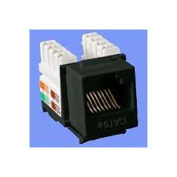
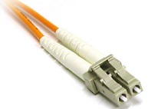
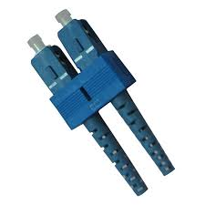
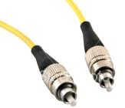
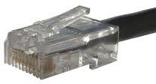
Interfaces & Connectors
Interface type | Inteface Speed | Connector types | Type / Cable | Supported Bandwidths
10BASE-T | 10Mbps | RJ45 | Copper Category 5 or better | Up to 10Mbps
100BASE-T | 100Mbps | RJ45 | Copper Category 5 or better | Up to 100Mbps
1000BASE-T | 1Gbps | RJ45 | Copper Category 6 or better | Up to 1Gbps
1000BASE‑SX | 1Gbps | LC-Duplex, SC-Duplex, FC/PC | 62.5µ multi mode fibre (MMF) | Up to 1Gbps
1000BASE‑SX | 1Gbps | LC-Duplex, SC-Duplex, FC/PC | 50µ multi mode fibre (MMF) | Up to 1Gbps
1000BASE‑LX | 1Gbps | LC-Duplex, SC-Duplex, FC/PC | 10µ single mode fibre (SMF) | Up to 1Gbps
10GBASE-SR | 10Gbps | LC-Duplex, SC-Duplex, FC/PC | 50µ multi mode fibre (MMF) | Up to 10Gbps
10GBASE-LR | 10Gbps | LC-Duplex, SC-Duplex, FC/PC | 10µ single mode fibre (SMF) | Up to 10Gbps
10GBASE-ER | 10Gbps | LC-Duplex, SC-Duplex, FC/PC | 10µ single mode fibre (SMF) | Up to 10Gbps
Copper | Optical
RJ45 | LC | SC | FC
Simple rule:
An interface can only support bandwidth speeds the same or lower than itself
A bandwidth must be supported by an interface the same or higher than itself

Slide 71

Introduction to Ethernet
3
© 2010 Colt Telecom Group Limited. All rights reserved.

Slide 72

What is Ethernet
Ethernet is defined by the IEEE in the 802.3 standard. It describes the protocols and hardware specifications used on Local Area Networks (LAN) and Wide Area Networks (WAN)
Bla
Bla
Bla
Bla
Bla
Bla

Slide 73


Ethernet History
At the beginning Ethernet was used in Local Area Networks, like offices, to communicate between PC’s or servers located on the same premises
All hosts used one common physical medium
When one host transmits data, all others connected to the same wire receive it, but only the destination host processes it
Office LAN
PC A
PC B
PC C
PC D
Server

Slide 74

Ethernet today
The previous slide shows how Ethernet was built originally – all hosts connected to the same cable (Coax)
Today each Ethernet device is connected to a port on a devices which repeat the signal. These Layer 2 devices used to be hubs, but now are mostly switches

Slide 75
Ethernet – Addressing
PC A sends data to the Server
PC’s B, C and D receive, but ignore it.
The data is contained in a logical unit called a Frame
All Ethernet data is grouped into frames which include a source and destination address
This is how the Server and the PC’s know who the frame is destined to
Office LAN
PC A
PC B
PC C
PC D
Server

Slide 76
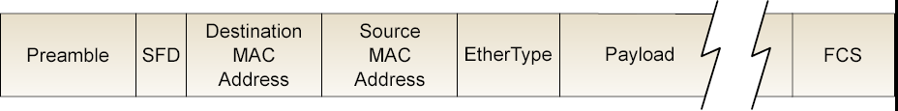

The Ethernet Frame
Frames are units of bits consisting of Ethernet protocol header information and the payload, which is of flexible length. The following are the most important fields:
Destination & Source MAC Address: MAC Addresses are hardware identifiers belonging to Ethernet devices (more detail later)
Payload: is the actual data being sent. The size is between 46 and 1500 bytes. If the data (e.g. a file) is bigger than 1,5Kb, it will be fragmented
FCS (explained later)
1111111100011110010100101011011011001100010001001100110101

Slide 77
The MAC Address
MAC Addresses are globally unique. They are written onto Ethernet devices during production by the manufacturer. It consists of 6 bytes / or octets, expressed in hexadecimal format.
The first three define the manufacturer and the last three the device.
Example:
00-0f-e2-89-fe-4b
Huawei
Device

Slide 78
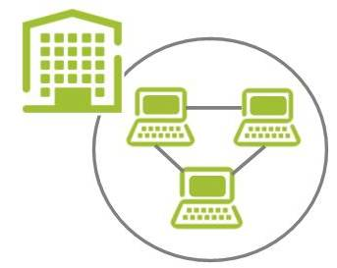
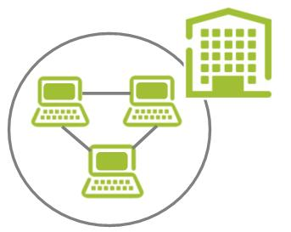
Ethernet for Wide Area Networks (WAN)
Ethernet was originally developed to connect computers located within a small radius like offices or university campus
Ethernet technology has evolved rapidly and has become very popular for WAN connections as well
LAN Link
Colt

